Slide 1
.Net Testing with NUnit

Slide 2
Objectives
Getting Started with Unit Testing using NUnit
NUnit Asserts
NUnit Attributes

Slide 3
Getting Started with Unit Testing using NUnit
.NET Testing with NUnit

Slide 4
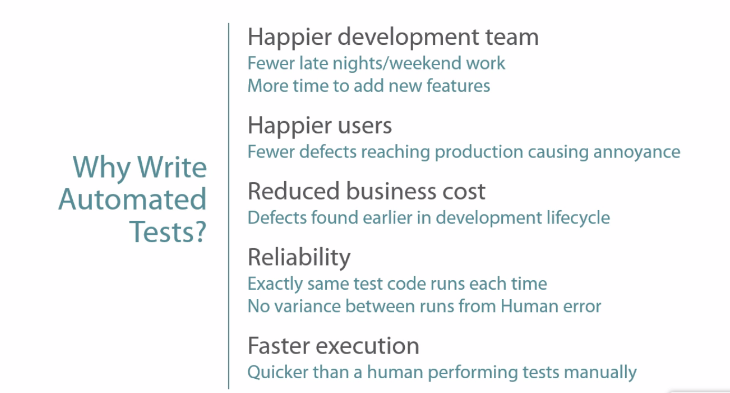
Notes:
4
Why Write Automated Tests?
Why do we want to write automated tests in the first place? There's a number of benefits.
First off, it helps to create a happier development team. One of the ways automated tests can help us in this regard is to find defects earlier in the development lifecycle process, so fewer bugs making it through to production means fewer late nights or weekend work trying to debug errors in production. Also, because we're spending less time firefighting problems in production, we actually get more time to work on new features or perhaps pay off some technical debt in the application.
Automated tests can help to create happier users. So because we're finding defects sooner in the application development process, fewer defects reach production, so this means fewer defects actually surfacing to end users. Defects that reach production could involve minor annoyances to the end user, which is still not good, or more serious problems which cause data loss or application crashes.
Automated tests can also benefit the business by reducing costs. Because we're finding defects now earlier in the development lifecycle, they're cheaper to fix. So, for example, if we've just written a line of code and we run our tests and they fail, we know we've caused a problem right there and then, as opposed to a few weeks or months down the road when we get a bug report from a customer, but they don't remember exactly what happened. We now have to go into the production environment, look through log files, and try to discover where the actual problem is. This creates additional cost for the business because rather than adding new features to the product the development team is now firefighting problems in production.
Some of the features of good automated tests include a sense of reliability. So we're running exactly the same test code each and every time we execute our tests. This means if nothing has changed in the code base we should get exactly the same results, pass or fail, that we did the last time. Also, because our testing is automated now, there's no variance between test runs due to human error. So, for example, if a developer or tester is running the application and checking that code features work, there's some potential now for human error in the process, which could result in bug reports when they're not actually bugs or misdiagnosis of existing bugs.
Automated tests also give us faster execution of our test runs, so we can more quickly execute a suite of tests that are automated than we can if a human has to perform these tests manually.

Slide 5
Testing Frameworks / Test Runners
Production Code
Test Code
Test Runner
Visual Studio Test Runner
Testing Framework
NUnit Test Adapter
NUnit
Notes:
Testing Frameworks and Test Runners
So before we look at NUnit itself, let's take a brief moment to consider the roles of testing frameworks and test runners.
So here we have our production code that we want to write tests for.
The first thing we're going to do is create a test project and write some test code that executes this production code.
Although it's possible to write this test code without using any kind of testing framework or test runner, for example, we could write a console application with a series of methods containing the tests.
A test framework, as its name implies, gives us a well thought out framework for organizing and executing our tests. So our test code can make use of a prebuilt existing testing framework, and NUnit is a popular example of one of these testing frameworks (MS Test is the build in testing framework that ships with Visual Studio).
So now we have our test code that's making use of this testing framework, we need some way to execute our tests. We can execute our test code by using test runners, and these come in a variety of shapes and sizes. The test runner that we're using understands the testing framework that our test code is using, so it knows how to identify individual tests that need running and also how to report on if these tests have passed or failed. After installing the Nunit Test Adapter extension in Visual Studio we can use the build in test runner of Visual Studio.

Slide 6
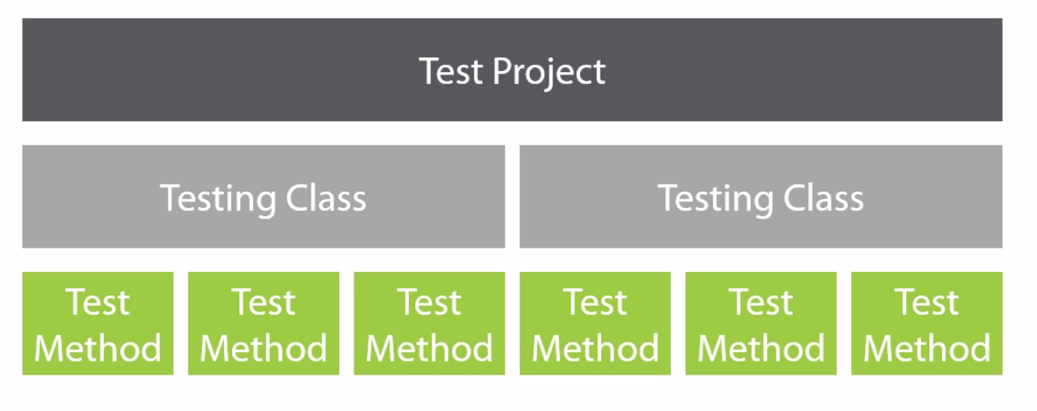
NUnit Test Suite Organizational Structure
Notes:
NUnit Test Suite Organizational Structure
So now we understand the benefits of automated tests and the place of testing frameworks and test runners. Let's start to look at NUnit in more detail now. The first thing we're going to look at is how we organize our suites of NUnit tests.
First off in Visual Studio we create a new test project that's going to test our production code. So in this test project we add a reference to our production code project. Generally speaking, it's not usually a good idea to mix our production code with our test code, that's why we create a separate project.
So now we've got our test project, we can go and add a reference to NUnit, and now we can start to write our tests. Within our test project, We create one or more testing classes, so these are just regular public classes that we apply specific NUnit attributes to, and we'll look at these attributes in just a moment. Inside our Test classes is where we actually write our individual test. So each test that we want to write is a public void method inside our testing class, and again, we decorate these test methods with NUnit attributes to indicate that they're tests that need executing by the test runner.

Slide 7
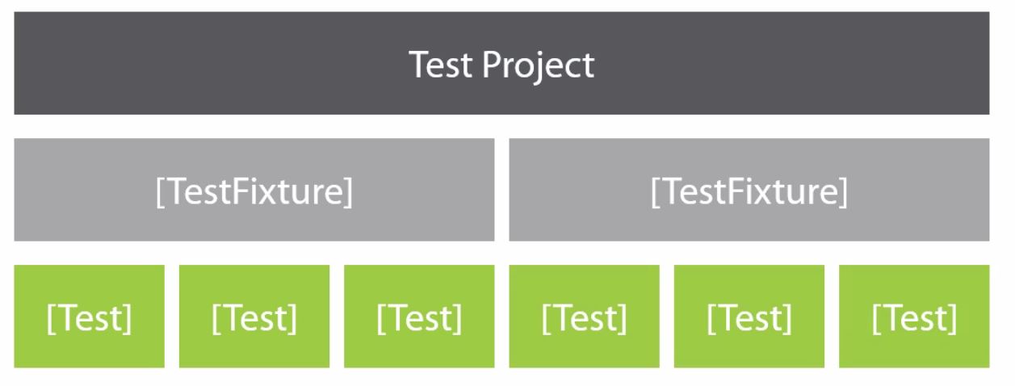
Designating Test Code
Notes:
Designating Test Code
Now we understand the basic hierarchy of our test suite, let's look at two important NUnit attributes that allow us to mark our Test classes and Test methods.

Slide 8
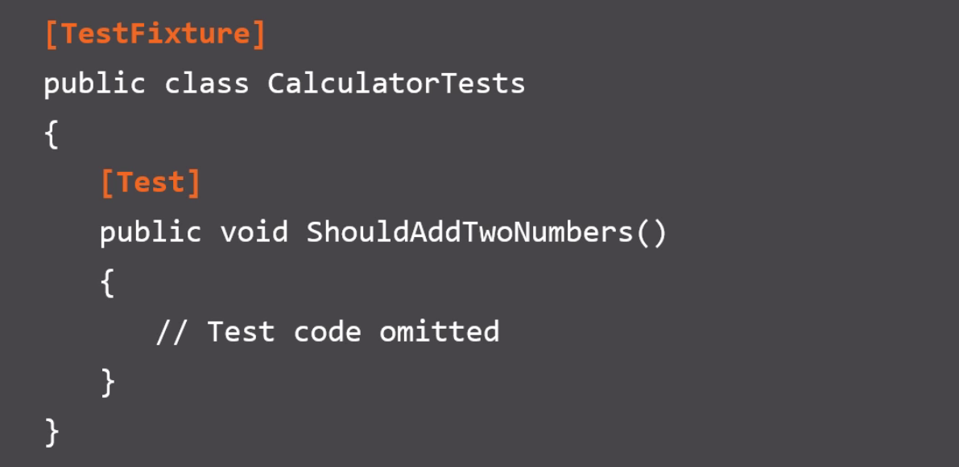
Designating Test Code
Notes:
Designating Test Code
Here we have our Test project and to our Test classes we add the TestFixture NUnit attribute. Within these TestFixture classes we have our tests and each test we mark with the NUnit Test attribute. We have two TestFixture classes or two TestFixtures, each one containing three tests. So let's look at these attributes in some code. We have a simple test class CalculatorTests, and at the moment it's just got a single method, ShouldAddTwoNumbers. To mark this class as an NUnit TestFixture, we apply the TestFixture attribute at the class level, and for each test in our TestFixture we apply the NUnit Test attribute. Our test runner will know to look in the CalculatorTests class for tests and it will also find a single test called ShouldAddTwoNumbers.

Slide 9
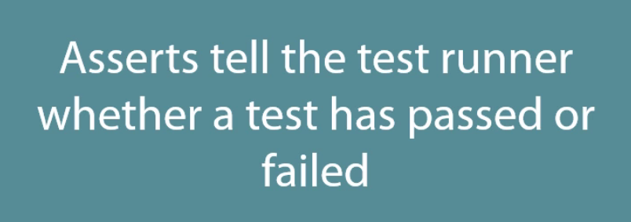
What are Asserts?
Notes:
What Are Asserts?
We're able to mark classes as TestFixtures and we're able to mark individual methods as tests, we can now execute production code in our test methods and get some results, but we need some way of telling the test runner whether the test has passed or failed. To do this we use Asserts, and essentially Asserts tell the test runner whether our test has passed or failed. We'll be looking at Asserts in more detail in the next module, but let's have a quick look at an example on the next slide.

Slide 10
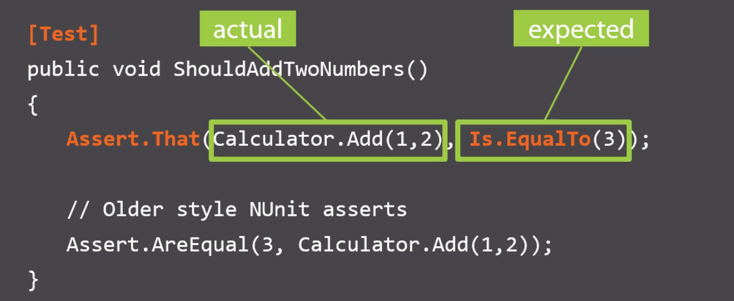
What are Asserts?
Notes:
What are Asserts?
We have a test ShouldAddTwoNumbers, (the surrounding Test class is omitted, just for brevity). Suppose we're testing the static Add method of a calculator, so we're going to call the Calculator's static Add method. We're passing the values 1 and 2, and we're using the NUnit Assert class to tell the test runner if the test has passed or failed.
We're asserting that when we add the values 1 and 2, the expected value is equal to 3. The first part of this Assert is the actual result from running our production code. The production code's Add method will be called with the values 1 and 2, and we'll get some result from this. The second parameter to this Assert.That method is our expected value. This is how we expect our production code to behave. We expect that when we add 1 and 2, we get a value that is equal to 3. There's an older style of NUnit asserts, which we won't be using in this course, but I just wanted to mention it here in case you see it in the documentation.

Slide 11
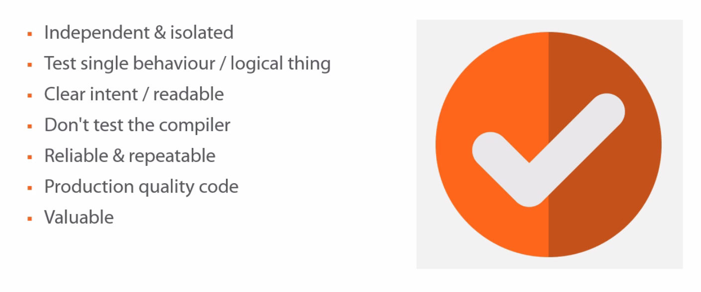
What Makes a Good Test ?
Notes:
What Makes a Good Test?
We're going to see how we can write our first NUnit test in just a moment, but let's first consider some factors that contribute to making a good test.
First off, each individual test should be independent and isolated from all of the other tests. If we have two tests, A and B, if test A runs and then test B runs, we should get the same result as if the order was reversed. If test B runs first and then test A runs, we should still get the same results for each test. In this way, the tests should be independent of each other, they should be able to be run in isolation or with a whole host of other tests and still get the same results.
Each test should test a single behavior or a single logical aspect of the system that we're testing, it's okay to have multiple Assert statements in a single test, as long as they're related to testing a single logical behavior. For example, in a single test for our calculator, we wouldn't have both the multiplication and addition being asserted on.
Just as with production code, the intent of this test should be clear to the reader, so we shouldn't have large sprawling test methods that are hard to read and hard to understand what the actual thing is we're testing.
We don't want to test the compiler, for example, if we're using C#'s auto-implemented properties we don't need to test that the Property Set and the Property Get is working correctly. The setting and getting for the values of our auto-implemented property are handled by the compiler, we don't need to test these. If, on the other hand, we're not using auto-implemented properties and we've got some code in our get or set, then this is something that we probably should test.
A good test is reliable and repeatable. It's reliable because we should always trust the output of the test. We shouldn't be second guessing it. Good tests should also be repeatable. That means they should produce the same result given the same set of circumstances, every single time. If the code base hasn't changed and a test sometimes passes and fails, then it's neither reliable nor repeatable.
As we alluded to, test code should be of equal quality as our production code, we should apply all of the same techniques that we use in production code to our test code.
Overall, tests should be valuable to the development team. We should always make sure that we get some benefit from the effort that we put into writing automated tests.

Slide 12
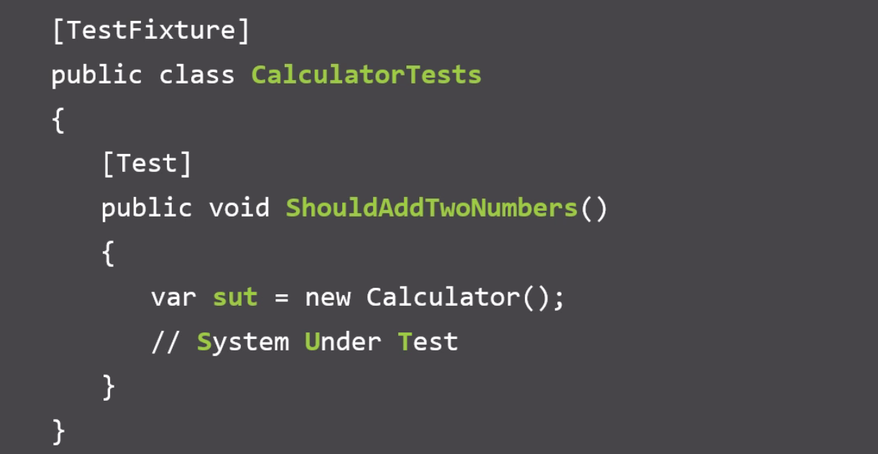
Naming Conventions
Notes:
Naming Conventions
In this course we're going to be using three distinct naming conventions. The first naming convention is at the TestFixture class level. The class name describes the logical thing we're testing followed by the word Tests, TestFixture contains tests relating to the calculator.
For individual test methods we're going to use a naming convention where we start the name of the test with the word should. This can help us to think about and clarify the actual behavior that we're testing in a single test.
In the body of our test here we're going to use the naming convention sut when we create an individual instance of the thing we want to test. For example, in our ShouldAddTwoNumbers, the thing that we're testing is the Calculator class. Here we're creating an instance of the Calculator class and assigning it to a variable named sut, and sut is an acronym which stands for System Under Test. By using this same naming convention in all of our tests, we can increase the readability of our tests and it's always clear in our test what the thing we're testing actually is, so all we need to do is look for the sut.

Slide 13
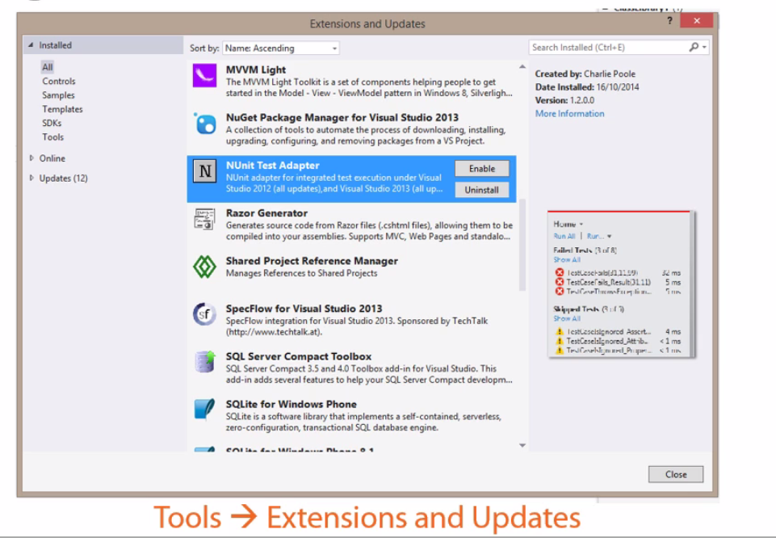
Enabling NUnit Test Executing in Visual Studio
Notes:
Enabling NUnit Test Execution in Visual Studio
Out of the box, the Visual Studio test runner doesn't recognize NUnit as a testing framework, but we can add support to Visual Studio. There's a couple of ways we can do this.
The first is to install the NUnit Test Adapter extension. To do this, simply go to the Tools menu in Visual Studio and head down to the Extensions and Updates menu option. You can search online and install the NUnit Test Adapter. Using this Visual Studio extension approach, each developer in the team will need this extension installed into their copy of Visual Studio.
As an alternative, we can also install the NUnit test adapter NuGet package. This approach means that we no longer need to use the Visual Studio extension, we can instead simply install this NUnit Test Adapter NuGet package into the solution.

Slide 14
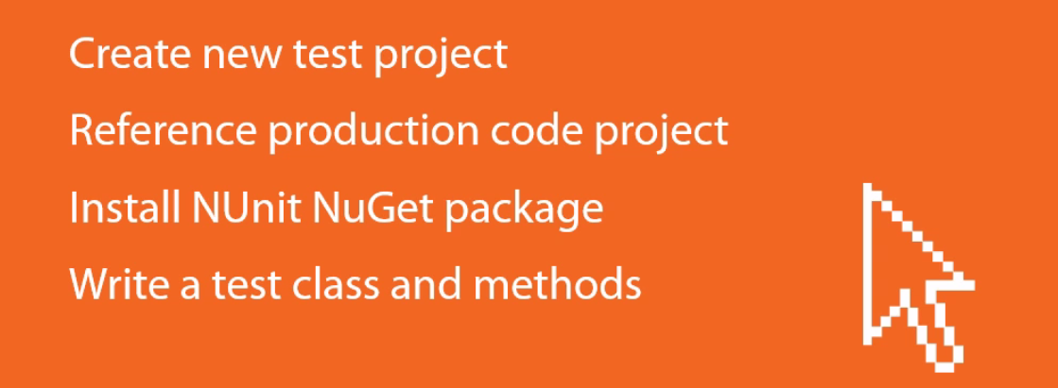
Writing an NUnit Test from Scratch

Slide 15


Writing an NUnit Test from Scratch: Demo
Notes:
Writing an NUnit Test from Scratch
In this demo we're going to create a new project to hold our tests. We'll then add a reference to our production code project so we can actually test it. We'll install the NUnit testing framework NuGet package, and then we'll write a Test class and add some Test methods.
If we have a look at the Solution Explorer, we can see we've got our production code, our Calculator project, and inside this we have a SimpleCalculator class which has an Add method and a Multiply method, and note we've got a Bug for demo purposes.
Let's Write some tests for this SimpleCalculator class. The first thing we're going to do is to add a new Test Project to our solution. We're going to add a class library project and we're going to call this CalculatorTests..
We need to add a reference to our production code from our Test Project, so I'll just go to Add Reference and tick the reference to our Calculator project.
Let's write a TestFixture class. The first thing we need to do is install NUnit, I'm just going to use Manage NuGet Packages here, and online I'm going to search for NUnit and I'm just going to install this main NUnit NuGet package here. Just hit Install, and that's NUnit installed.
We can now make use of the NUnit's attributes and NUnit's Asserts. We'll rename this default class that we got in our new testing project. We'll call this CalculatorTests, matching our naming convention, and we need to mark this Test class with the TestFixture attribute from NUnit. We can see here the NUnit.Framework namespace has been added.
We have our TestFixture class that we can write tests inside. We'll start off by using the NUnit Test attribute, and we'll add a public void method, and we're going to call this ShouldAddTwoNumbers. That's our first test method.
We'll now need to implement the actual test code. The first thing we're going to do is create an instance of our System Under Test, and this is our SimpleCalculator from our production code project. We got an instance of our system under Test, we can actually execute some behavior on it.
We're testing the SimpleCalculator's Add method. We're going to call our System Under Test's Add method, and we'll just add the numbers 1 and 2 together. The final thing we need to do is add our Assert to say whether this test has passed or failed.
We're going to use NUnit's Assert.That method, and the first parameter we pass here is actually the result of running our production code. It's our Result variable, which comes from calling our Add method. The next thing we need to do is specify what the expected outcome is of running this method. We want to choose Is.EqualTo, and then the value we expect, what we expect when we add 1 and 2 together to get the value 3. That is our first test.
Let's add a second test to test the SimpleCalculator's Multiply method here. So, again, we've applied the Test attribute, and our test is called ShouldMultiplyTwoNumbers. Again, we create an instance of our System Under Test, we then execute our production code, and we assert that the result is as expected. We're saying that we expect when we multiply 2 and 10 we get the value 20. And we can build.
If we open the Visual Studio test runner and we can do this by going to the Test menu, heading down to Windows, and choosing Test Explorer. Notice that we don't get any tests showing up, and that's because we haven't installed the NUnit test adapter, so let's go ahead and do this. So we'll go to our Test project here, we'll go to Manage NuGet Packages, and online again we'll search for NUnit, and this time we're going to install the NUnit Test Adapter for Visual studio. By doing this, we don't need to install the Visual Studio extension. This package will enable the Visual Studio test runner to recognize NUnit.
Let's install this, and just close, and if we go to our Test Explorer now we can't see any tests showing up yet, but if we rebuild the solution we can now see our tests showing up.
There's a number of different ways we can order things. We can order them by Class, Duration, Outcome, Traits, which we'll look at in the final module, and also by Project. So we've only got two tests here, so this is looking quite similar, regardless of what we choose.
We can run our tests. So we can either run all of the tests in our solution here, we can right-click and just run all of the tests underneath our CalculatorTests project, or we can right-click on individual tests and run those. Let's start by running our ShouldAddTwoNumbers test. I'm going to right-click and choose Run Selected Tests. So now the test runner has executed the code in our test method, and we can see here that our test has passed because our Assert was correct. We can just prove this is running by putting a breakpoint inside our test code here and instead of right-clicking and choosing Run Selected Tests, we're going to choose Debug Selected Tests. Now our test executes, but this time in Debug mode, so our breakpoint gets hit. So we can see our test is running, and we can see our results here from adding two numbers is 3, so our Assert here that's checking for the value 3 will pass.
Let's run this ShouldMultiplyTwoNumbers test The test executes, and notice that we've got this red cross, and our test has failed. If we look at the test output message, we can see that our test Assert expected the value 20, but it was actually 12. So we can see down here we're expecting the value 20 but we actually got 12, and that's because there's this deliberate bug in this Multiply method. We've got a typo. We should be using the Multiply operator. So let's just fix that up. We'll go back to our tests. This time I'm going to run all test, and notice now that our Multiply test passes along with the other tests in the solution.

Slide 16
NUNIT Asserts
.NET Testing with NUnit

Slide 17
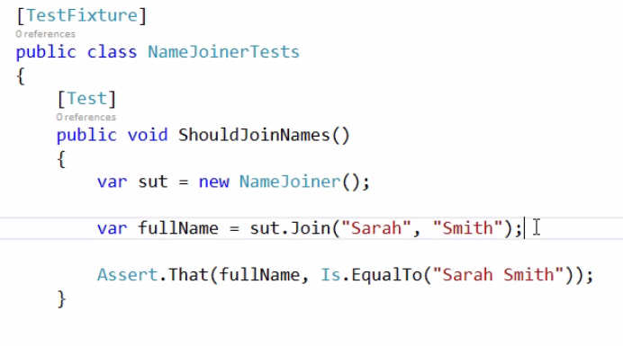
String Equality : Is.EqualTo()
Notes:
Is.EqualTo()
We have a NameJoiner class that we'll be writing a few tests for, and all this does is it takes a firstName and a lastName and just joins these two together and returns them as a string. The first test, ShouldJoinNames, we're following a similar pattern of creating our System Under Test, and then executing some action on our System Under Test, We're calling the Join method and we're getting the result of this Join method. We're using the Assert.That method, passing in the actual value that we got back from our System Under Test, and then we're using the Is.EqualTo method and passing in the string that we expect to get back, so in this case it's "Sarah Smith".

Slide 18
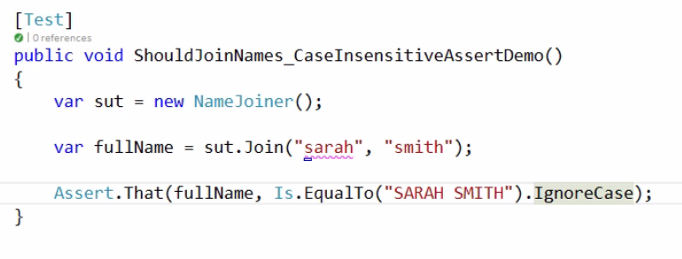
Is.EqualTo().IgnoreCase
Notes:
Is.EqualTo().IgnoreCase
Here's another example of using Is.EqualTo with a string, but this time we're using uppercase just to demonstrate. When we run the test, it's going to fail because we expected the name Sarah Smith in uppercase, but we actually received sarah smith in lowercase. So if we don't care about the case of the equality check here for our string, we can add .IgnoreCase here

Slide 19
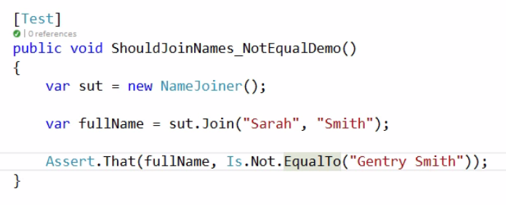
Is.Not.EqualTo()
Notes:
Is.Not.EqualTo()
If we want to test that a string is not equal to something that we expect, we use Is.Not.EqualTo(). If we want to check for inequality, we can simply add Not. This whole Assert is saying Assert.That (fullName, Is.Not.EqualTo("Gentry Smith")), and because we're getting Sarah Smith back, this test should pass, which it does.

Slide 20
Asserting String Equality: Demo

Slide 21
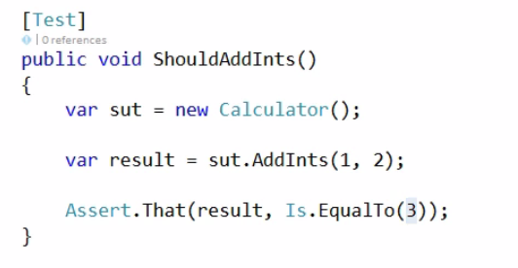
Numerical Equality
Notes:
Numerical Equality
We can also use the Is.EqualTo method to compare numerical values. We have this simple Calculator class and it's got a few methods We've got an AddInts method, which adds two ints and returns an int. We've also got an AddDoubles method which takes two doubles and returns the sum of two doubles. We've also got a Divide method which we'll be looking at later in this module when we look at exception handling. We've got a simple ShouldAddInts test, and we're calling the AddInts method and adding 1 and 2 together, so we expect the value to be 3. So that's using Is.EqualTo and specifying an integer value.

Slide 22
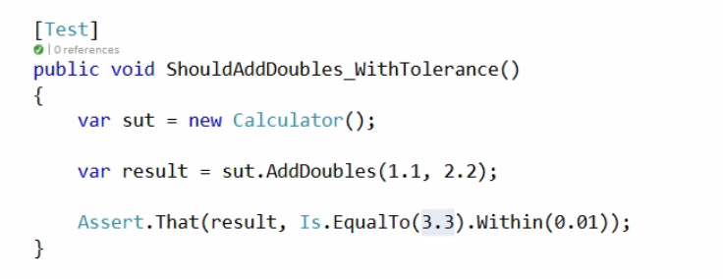
Is.EqualTo().Within();
Notes:
Is.EqualTo().Within()
Let's see what happens when we use floating point values. We’re just using the AddDoubles method instead, and we're adding the values 1.1 and 2.2. We’re saying we expect a value to be equal to 3.3, but when we run the test, it won’t pass. Because we're using floating point numbers, the expected value is 3.29999. So, because we're using floating point values, we're not always going to get an exact value. So with NUnits we can add a call to the Within method, and the Within method would allow us to specify a tolerance for our EqualTo. We're saying that we expect the result to be equal to 3.3, but we're going to allow a tolerance of + or - 0.01. If the result is between 3.29 and 3.31, this test should pass.

Slide 23
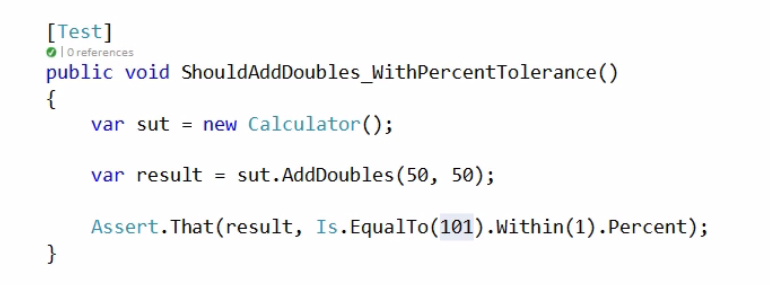
Is.EqualTo().Within().Percent
Notes:
Is.EqualTo().Within().Percent
In addition to specifying an actual tolerance value, we can also specify it as a percentage. We're adding the values 50 and 50, so we should get 100 back, but notice the Assert we're saying is equal to 101, which is clearly wrong. Because we're using the Within method and specifying a value of 1 followed by the .Percent, we're saying that the tolerance is 1%. So even though we're going to get 100 back, because our tolerance here is 1%, this test will actually pass.
One thing to be careful of when using the Within method is to be careful that we don't actually get passing tests when we should get failing tests because of incorrectly specified tolerance values. So if we're adding the values 1.1 and 2.2, but if we're checking that it's equal to 30, is clearly wrong. Because when we use a tolerance of 100, this means that the actual result can be anywhere from -70 to 130. It's always worth double-checking the tolerance values that we use when we use the Within method.
When we're working with numeric values, in addition to using the Is.EqualTo method, there's a number of other useful shortcuts we can use. One of these is Is.Positive, so rather than using Is.EqualTo and specifying a value, we can say is the number positive. Similarly, we can specify Is.Negative instead of Is.EqualTo, and if we want to check that a number is not a number we can use the Is.NaN.

Slide 24
Asserting Numerical Equality: Demo

Slide 25
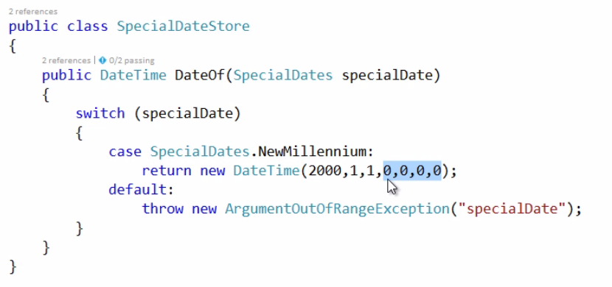
Asserting DateTime Equality
Notes:
Asserting DateTime Equality
How can we use the Is.EqualTo method to compare DateTimes. We have a SpecialDateStore class, and it's just got a method called DateOf, which returns an instance of a DateTime, depending on which SpecialDate enumeration value has been passed in. We’ve just got one for the NewMillenium, and if we specify SpecialDates.NewMillenium, we'll get back a DateTime instance for 2000, January the 1st, and midnight,.

Slide 26
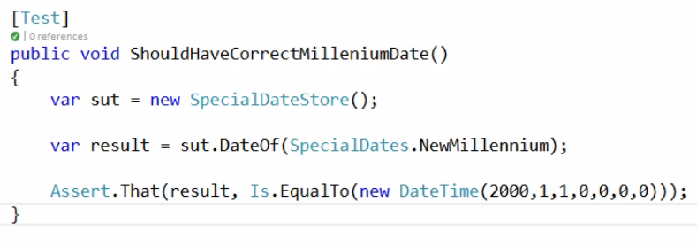
Asserting DateTime Equality
Notes:
Asserting DateTime Equality
In our test, we can simply create a System Under Test, get the result of the DateOf call, and check that the result Is.EqualTo. Rather than specifying the string or numeric values we've done previously, we can specify a DateTime to compare against, so again, here we're using the 1st of January 2000.

Slide 27
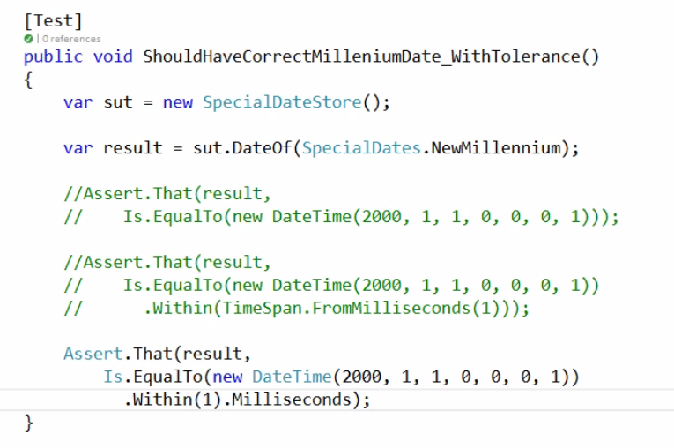
Asserting DateTime Equality
Notes:
Asserting DateTime Equality
Just as with numerical values, we can also specify tolerances. We’re comparing the NewMillenium, again, the 1st of January, 2000, but on here we’re specifying an additional millisecond (first example in comment). So if we run this it will fail because the two DateTimes are different, they're a millisecond apart. If we want to use tolerances with DateTimes we can.
Now we look at the second block of code (in comment). We're still using EqualTo, specifying the DateTime we expect, this is the one with the 1 millisecond difference. As with the numeric values, we're using the .Within method to specify a tolerance, and here we're just specifying a tolerance as a TimeSpan using TimeSpan.FromMilliseconds static method. We're specifying a tolerance of + or - 1 millisecond. When we run this, our test passes because we have a tolerance.
In addition to using the Within method and specifying a TimeSpan, we can instead use NUnit's fluent syntax here. We’re using the Within method and specifying the value. We're then adding the .Milliseconds to it. This is essentially the same as the previous method when we specified an explicit TimeSpan.

Slide 28
Asserting DateTime Equality: Demo

Slide 29
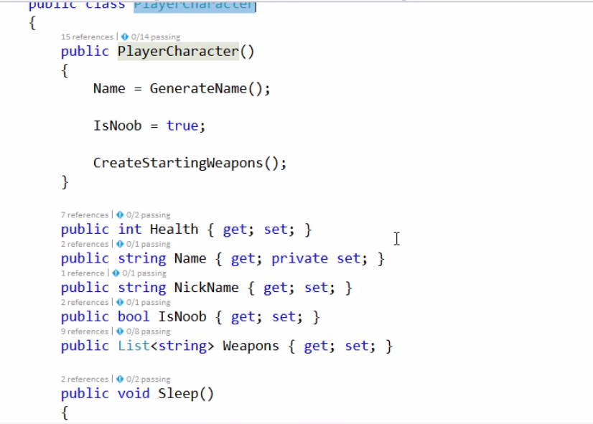
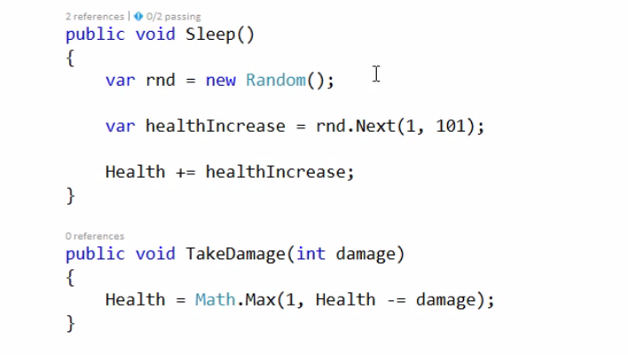
Asserting with Ranges
Notes:
Asserting with Ranges
In addition to using the Is.EqualTo method to check that the value is as we expect it to be and perhaps with some tolerance, we could also check that a value falls within a specific range.
We have a PlayerCharacter class, and this represents a player in a fantasy role-playing game. We have a number of properties such as Health, a list of weapons they might have, and we have a couple of public methods here, Sleep and TakeDamage. Notice in this Sleep method, when it's called we'll get his healthIncrease to the player's health and when the player sleeps, the amount of health that they get back, so they'll get between an additional 1 and 100 health points back.

Slide 30
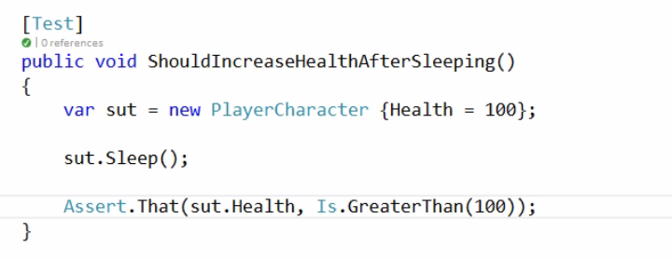
Asserting with Ranges
Notes:
Asserting with Ranges
We’re creating a new PlayerCharacter and setting its initial health to 100. We're calling Sleep in our System Under Test, and we want to make some assertation on the resulting health of our PlayerCharacter. Because we get a random increase, we don't know exactly what this result in health would be, so instead we can use ranges here. Rather than using Is.EqualTo, we're using the Is.GreaterThan method. As its name suggests we can supply a value and this will assert that the value is more than 100, so in this case it should be 101 or greater.

Slide 31
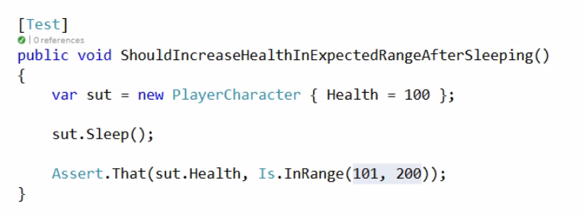
Asserting with Ranges
Notes:
Asserting with Ranges
This test doesn't really capture the fact that this should get between 1 and 100 health back, which is saying as long it's greater than 100 this test will pass. So if we made a typo in our the PlayerCharacter class in the Sleep method, and say we made the 101 1010 in the rnd.Next statement, then our test here will still always pass, but we haven't checked the upper bound here.
As an alternative to the GreaterThan, if we want to check that a value falls within a specific range, we can instead use the Is.InRange method. This method takes the lower bound and the upper bound of the range, inclusive that we want to check. We're saying the resultant health should be between 101 and 200. If it's less than 101 or greater than 200 our test will fail.
There's a number of other ways we can use range-related Asserts in NUnits. So, for example, we could use the Is.GreaterThanOrEqualTo, so our Assert will pass if the value is greater than or equal to the value we specify. We can use Is.LessThan to check for the value Is.LessThan a value, and it's accompanying Is.LessThanOrEqualTo method.

Slide 32
Asserting with Ranges: Demo

Slide 33
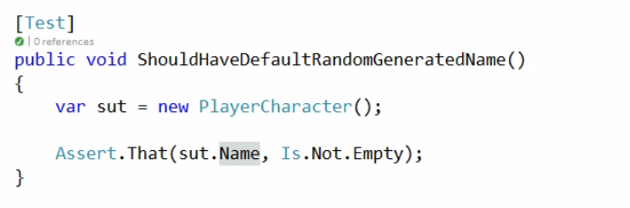
Asserting Nulls and Booleans
Notes:
Assert Nulls and Booleans
Let's see now how we can assert that values are null or empty and also how we can assert that Boolean values are true or false. When we create a new PlayerCharacter we get a default generated name, and this generated name comes from the GenerateName method, which just picks a random generated name from this list so we have some fantasy-sounding names here such as Shalnorr. In our test, we want to check that when we create a new PlayerCharacter that they should have a default random generated name, so in this case we want to check that the Name property of our PlayerCharacter isn't empty. So here we're using Is and applying the Not modifier because we're checking for inequality. We're then using the Empty property. We’re asserting that the string property Name is not empty. Let's run this, and it passes.
If we were to go into our PlayerCharacter and instead set the name to an empty string, if we run the test it will fail because we expected a string not to be empty, but it was, in fact, empty.

Slide 34
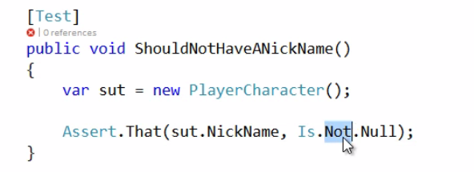
Asserting Nulls and Booleans
Notes:
Assert Nulls and Booleans
If we want to check for Not.Null we could again apply the Not modifier and our test will now fail because we're saying the NickName should not be null when it actually is. Let's just fix that.

Slide 35
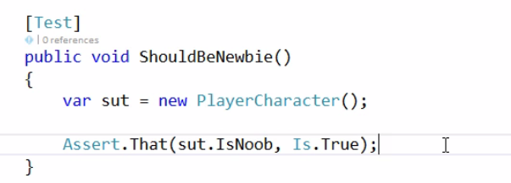
Asserting Nulls and Booleans
Notes:
Assert Nulls and Booleans
We can also check for Boolean values. So when we create a new PlayerCharacter, we're going to set this IsNoob Boolean to true. So we can see here we're setting the IsNoob property to true. So if we run this, we can see now that a new PlayerCharacter is assigned the default value of IsNoob, True. Alternatively, we can use False here to check for a False Boolean value, and of course now this will fail because the value was expected to be False, but was, in fact, True

Slide 36
Asserting Nulls and Booleans: Demo

Slide 37
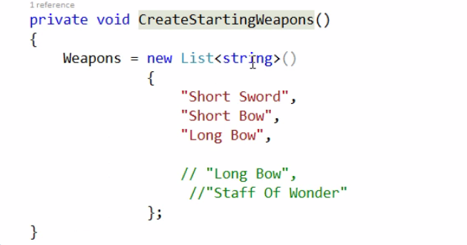
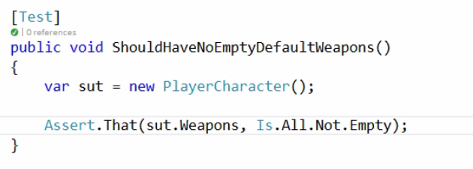
Asserting on Collections
Notes:
Asserting on Collections
There's a number of ways NUnit provides us methods to check the collection is as we expect it to be. We have our PlayerCharacter as before, and when we create a new PlayerCharacter, we get some default StartingWeapons. The CreateStartingWeapons method where we create our list of weapons just represented as a list of strings. We get the default weapons, "Short Sword", "Short Bow", and "Long Bow". Let's look at some of the ways we can assert that this Weapons collection is as we expect it to be.
In the test we want to check that the list of weapons here doesn't contain any empty strings. An empty string is obviously not a valid description for a weapon. So in this case, we can use the Is.All which will go through our collection of weapons and for each item in that collection make an assert against it. So each item in the Weapons collection should not be Empty.

Slide 38
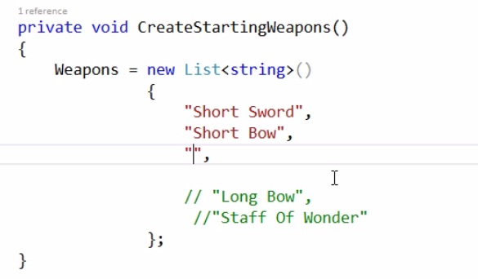
Asserting on Collections
Notes:
Asserting on Collections
If we introduce an empty weapon in the method, our test now will fail because one of the items is empty. If any one of the items in the collection doesn't match the Empty check, the entire Assert will fail.

Slide 39
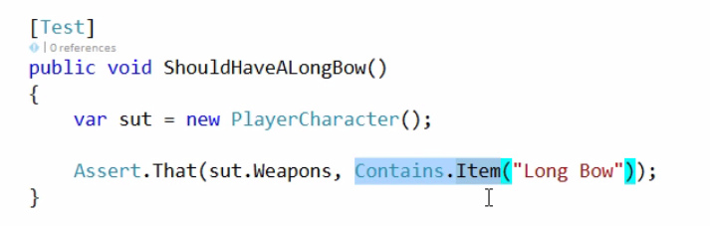
Asserting on Collections
Notes:
Asserting on Collections
If we want to check that a collection contains at least one instance of a specific item, we can use the Contains.Item method. So this Assert will pass if at least one of the items in the collection matches this "Long Bow" description.

Slide 40
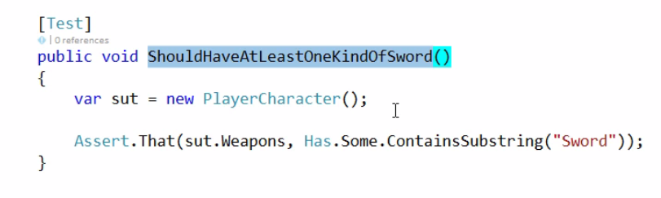
Asserting on Collections
Notes:
Asserting on Collections
A PlayerCharacter has Weapons and one of the weapons is a sword, "Short Sword". So if we want to check that at least one of these weapons is a sword, we could write a test, ShouldHaveAtLeastOneKindOfSword and use the Has.Some constraint, which will pass if any one of the items matches this constraint, which is checking that at least one of our weapons contains the word sword.

Slide 41
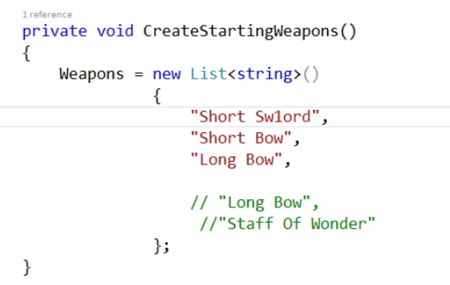
Asserting on Collections

Slide 42
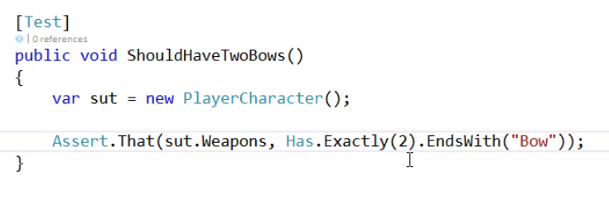
Asserting on Collections
Notes:
Asserting on Collections
If we want to check that a collection has a specific number of certain items, we can use the Has.Exactly method and specify the count of the number of items we expect. Our list of weapons should have exactly two items that end with the word Bow, We have a "Short Bow" and a "Long Bow", so this test will pass, which it does. If we remove one of these bows, the test will now fail because we expected to have two bows, where now we've only got one.

Slide 43
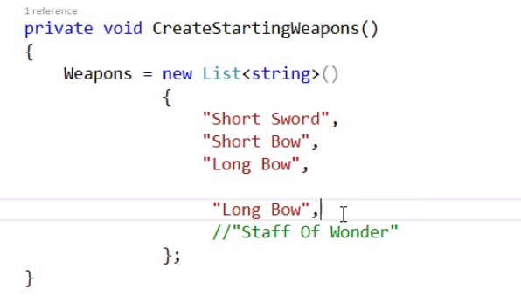
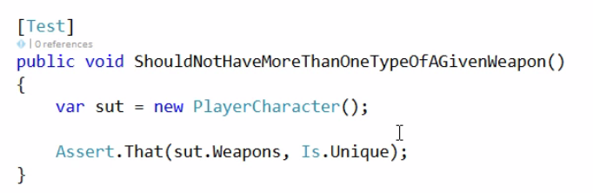
Asserting on Collections
Notes:
Asserting on Collections
We also want to check that when we create a new PlayerCharacter, that we don't have more than one type of a given weapon,
We use the Is.Unique constraint to check that all of the weapons for our PlayerCharacter are unique. If we run this test, it passes, but if we add another "Long Bow", our test now fails, because all of the items in the collection are no longer unique.

Slide 44
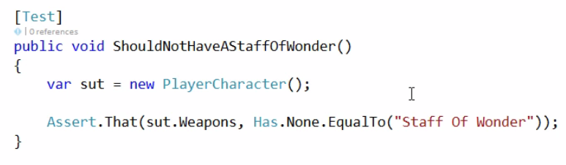
Asserting on Collections
Notes:
Asserting on Collections
If we want to check that a collection doesn't contain a specific item, we can use the Has.None constraint, there should be no weapons that are equal to "Staff Of Wonder".
If we actually add a "Staff of Wonder", our test will fail.

Slide 45
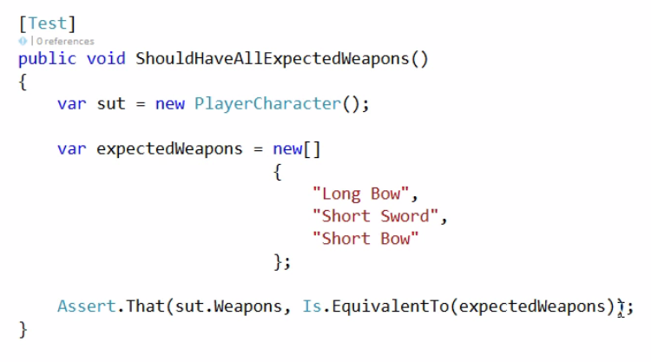
Asserting on Collections
Notes:
Asserting on Collections
If we want to be explicit and check that the collection of default weapons contains exactly the correct items, we can use the Is.EquivalentTo method to check the list of weapons contains exactly the same elements as we expect. We've got a variable, expectedWeapons, and we're specifying all of the default weapons we expect a new PlayerCharacter to have, but notice "Long Bow" comes first in expectedWeapons variabele and “Long Bow" comes last in the PlayerCharacter class. So the Is.EquivalentTo method won't check the order, it will just check that the items are equivalent.
If we were to remove one of these items and run the test again, our test will now fail because the list of items is not equivalent.

Slide 46
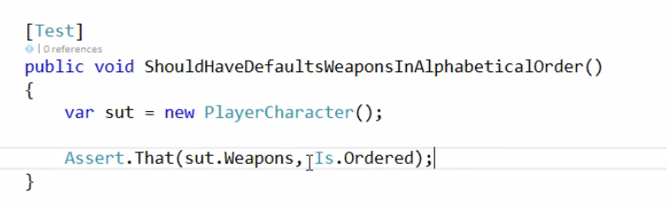
Asserting on Collections
Notes:
Asserting on Collections
Finally, if we want to check a collection is in order, we can use the Is.Ordered constraint, this will check that our list of weapons is in alphabetical order. And if we run the test, we can see that it fails, because our list here is not in alphabetical order. Let's fix this. So now our list is in alphabetical order, "Long Bow", "Short Bow", "Short Sword". If we run the test again, our test now passes because all of the items in our Weapons collection are ordered.

Slide 47
Asserting on Collections: Demo

Slide 48
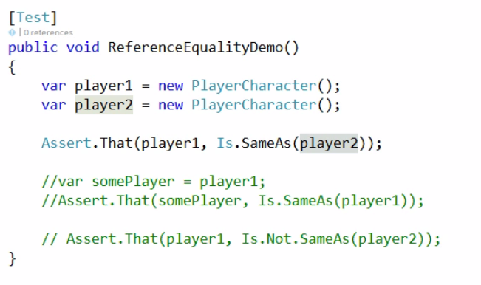
Asserting Reference Equality
Notes:
Asserting Reference Equality
In addition to checking that values are equal, we can also test that two references point to the same object. To demonstrate this I've created two PlayerCharacters here, player1 and player2. So we have two distinct instances of PlayerCharacter now, and if we Assert that player1, we're using Is.SameAs here, player2, this is going to fail because player1 doesn't point to the same instance as player2.

Slide 49
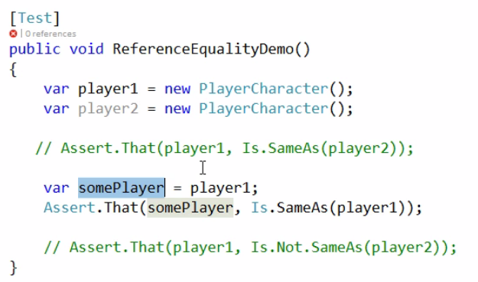
Asserting Reference Equality
Notes:
Asserting Reference Equality
Let's just comment out the Assert and have a look at the second version. We’re creating a new variable somePlayer and we're assigning this to player1. So now somePlayer and player1 both point to the same PlayerCharacter. If we Assert.That somePlayer is the same as player1, this will pass.

Slide 50
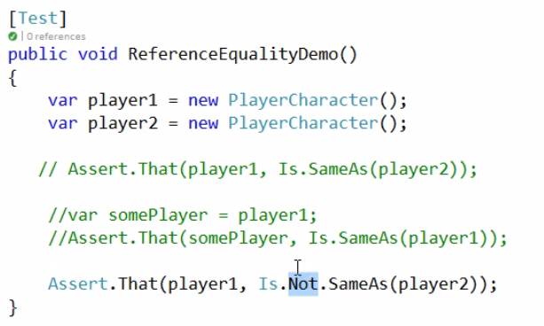
Asserting Reference Equality
Notes:
Asserting Reference Equality
We can also use the Not operator. We’re testing that player1 is not the same as player2, which is correct, these are both separate instances, so the test will still pass.

Slide 51
Asserting Reference Equality: Demo

Slide 52
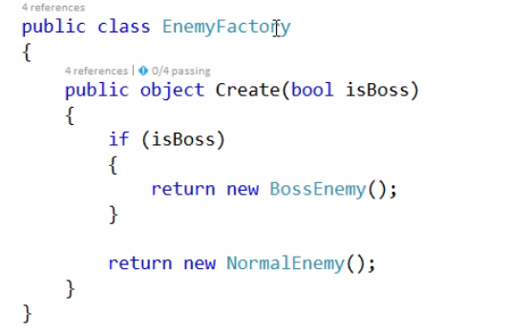
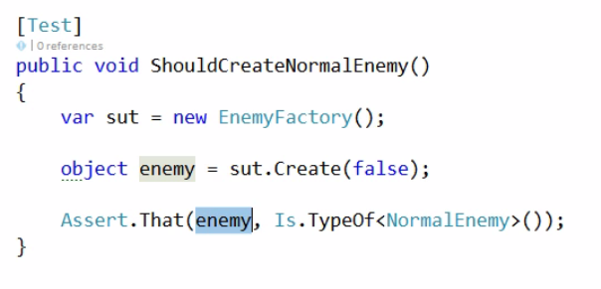
Asserting Object Types and Properties
Notes:
Asserting Object Types and Properties
We can use NUnit to assert that objects are of the correct type and also that objects have expected properties.
We have an EnemyFactory class, and this just contains a single method, Create, that returns a weakly-typed object. We can also specify whether we want to create a BossEnemy, in which case we return a new BossEnemy. Otherwise we return a new instance of a NormalEnemy. Because this is a weakly-typed object here, you may want to write some tests that check that we get the correct type of enemy returned.
In the ShouldCreateNormalEnemy. Test, we create our System Under Test, and we're calling the Create method of our EnemyFactory and passing false because we want to create a NormalEnemy and not a BossEnemy. We're going to get an object back. To check that the enemy that we get back is a NormalEnemy, we can use the Is.TypeOf constraint and pass it in this generic type here, the type of object that we expect.
We're saying that we expect our enemy to be a NormalEnemy.

Slide 53
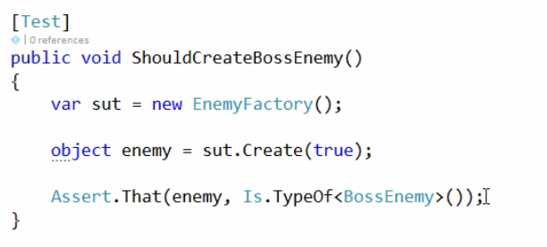
Asserting Object Types and Properties
Notes:
Asserting Object Types and Properties
We can also check now that we get a BossEnemy created if we pass true to this Create method.

Slide 54
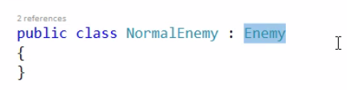
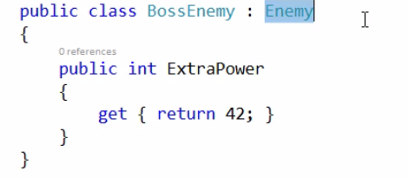
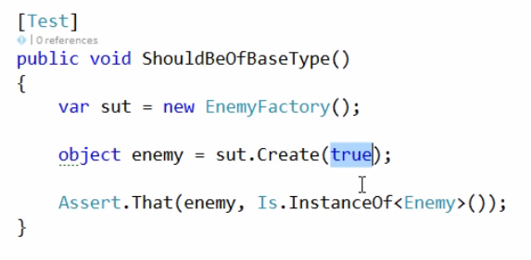
Asserting Object Types and Properties
Notes:
Asserting Object Tpes and Properties
We can also check that an object is an instance of some kind of BaseType. We can see in the NormalEnemy class we inherit from the Base class Enemy and also BossEnemy here inherits from Enemy as well. When we create something using the Create method, whatever we get back is an instance of Enemy. Because we're passing true, we're going to get a BossEnemy which inherits from Enemy. By using the Is.InstanceOf method, we can check that an instance is of a specific type.
If we were to not inherit from Enemy in our Boss here and run this again, our test will fail because BossEnemy is no longer an instance of Enemy.

Slide 55
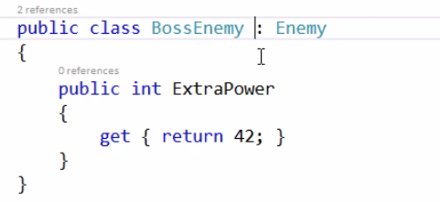
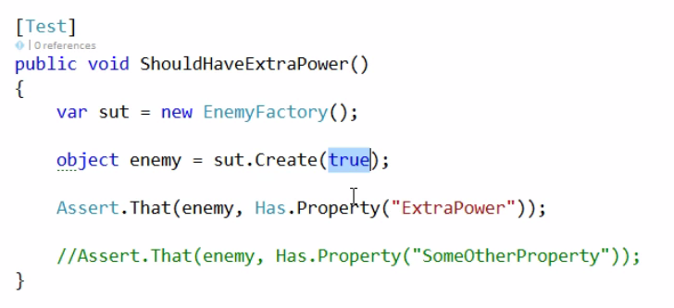
Asserting Object Types and Properties
Notes:
Asserting Object Types and Properties
We can also use the Has.Property method to check that an object has a specific named property. We’re going to press true to get a BossEnemy, and now we're going to check that this resultant object has a property called "ExtraPower". We can see that the BossEnemy indeed does have a property called "ExtraPower", so this test should pass. If we add an additional Assert now to check that BossEnemy also has a property called SomeOtherProperty, our test will now fail because the object doesn't have a property called SomeOtherProperty.

Slide 56
Asserting on Object Types and Properties: Demo

Slide 57
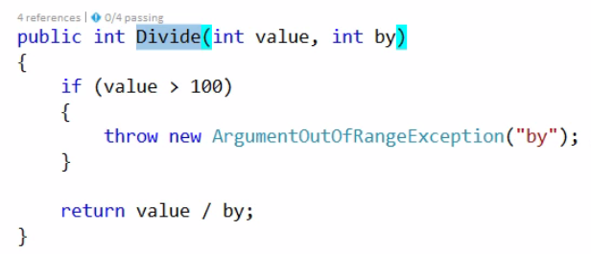

Asserting Exceptions are Thrown
Lambda expression
Notes:
Asserting Exceptions Are Thrown
The final kind of Asserts we're going to look at in this module is how we check that our code throws the correct exceptions.
We're going to look at some tests against our Calculator class that we saw earlier in the module, and we're going to test this Divide method.
The first test we're going to write is that it should error when we try and divide something by zero.
To check that a piece of code throws an exception, we still use the Assert.That method, but this looks a bit different now.
The first parameter is a delegate to the code we want to execute that we expect to throw the exception.
We're saying when we call the Divide method with these parameters that we should throw an exception.
We're not specifying the type of exception that we want, we're just saying that if any exception is thrown, then our Asserts will pass.
New C# syntax: Lambda expressions
The first parameter in the ‘Assert.That’ method is a delegate. A delegate is a type (just like reference types and value types) that encapsulates a method.
A delegate variable/parameter can hold a reference to a method with a certain signature.
So the first parameter in the ‘Assert.That’ is a reference to a method that will be executed in the ‘That’ method.
What you see in the slide is a special form of a delegate: a lambda expression.
A lambda expression is an anonymous function (a method without a name) that you can use to create delegates on the spot.
The parameters of the method are on the left of the ‘=>’ and the method body is on the right.
So basically we defined a method and passed it as a parameter in one go.
More info:
https://docs.microsoft.com/en-us/dotnet/csharp/programming-guide/statements-expressions-operators/lambda-expressions
http://www.tutorialsteacher.com/linq/linq-lambda-expression

Slide 58

Asserting Exceptions are Thrown
Notes:
Asserting Exceptions are Thrown
There's a subtle problem here. If we look at our Divide method, we can see that we get this ArgumentOutOfRangeException thrown if we pass in a value more than 100. We can see here that we're passing in a value of 200, so we're actually going to get the ArgumentOutOfRangeException thrown here as opposed to the DivideByZero exception that we're expecting in our test. So checking for any kind of exception is not usually a good idea. With NUnit we can use the Throws.TypeOf and then pass the type of exception that we're expecting, so here we're being a lot more explicit about the kind of exception that we want.
Our test is actually failing. We've expected a DivideByZero Exception, but we're actually getting an ArgumentOutOfRangeException, and that's because the value we've passed in is more than 100 so we're getting this ArgumentOutOfRangeException thrown.

Slide 59

Asserting Exceptions are Thrown
Notes:
Asserting Exceptions are Thrown
We can see that our first test was actually not testing the correct thing. We can fix this by passing 99. Our Divide method will throw the DivideByZero exception and our test will pass.

Slide 60

Asserting Exceptions are Thrown
Notes:
Asserting Exceptions are Thrown
Let's write a test for this check for the value being more than 100. We'll start off with this version of the test, we're dividing a value more than 200, and we're not dividing by zero this time, and we're expecting an ArgumentOutOfRangeException because this value is more than 100. Our test passes, but there's also a subtle problem with this test.

Slide 61


Asserting Exceptions are Thrown
Notes:
Asserting Exceptions are Thrown
If we look at our Divide method, there's a deliberate bug here, we're throwing an ArgumentutOfRangeException for the "by" parameter (already changed to ‘value’ in the slide), when it should be for the value parameter. We could be more explicit still. We divide 200 by 2 as before, and as before we test Throws.TypeOf<ArgumentOutOfRangeException>, but this time we're going to use some additional functionality from NUnit. Using the .With property, we're going to add an additional constraint, We're going to use this Matches method, which allows us to specify the predicate. We're additionally checking that our ArgumentOutOfRangeException represented by this x parameter has a parameter name of Value. So if we run this it's going to fail because we are setting the parameter name incorrectly to by. We'll change it to the correct parameter name, which is value. Now our test is checking that we get an ArgumentOutOfRangeException, and the exception's ParamName property is == "value", and now we can see our test passes.

Slide 62
Asserting Exceptions are Thrown: Demo

Slide 63
NUNIT ATTRIBUTES
.NET Testing with NUnit

Slide 64

Running Code Before and After Each Test
Notes:
Running Code Before and After Each Test
So let's kick off this module by seeing some of the different ways we can run code before and after tests.
In this first demo, we're going to see how we can run code before and after each test in the TestFixture.
We have a MemoryCalculatorTests class.
We can see we've got a couple of tests, ShouldAdd and ShouldSubtract, and we've created our System Under Test in a field inside the class, and we're just creating an instance of this memory calculator at the class level.
We're adding the value 10 and then adding the value 5, and then we're asserting that we get the result of 15. The test passes as expected.
We also have a ShouldSubtract test, and we're just subtracting 5, and then we're asserting that we end up with -5. This test passes, but if we try and run both of these tests in a single test run, one of them will fail.
We can see that the ShouldSubtract test has failed, and if we look at the failure message we expected -5, but we actually got 10.
This is because we're only creating this instance once each time we execute this TestFixture.
We get our ShouldAdd test execute, and this will pass, but at this point the memory stored in our MemoryCalculator instance is equal to 15. When the next test runs, we're subtracting 5 from 15, which means we get this value 10 and our test fails, and this is because we're not creating a new instance of our System Under Test for every test that executes within this TestFixture.
We could move the declaration down and declare it multiple times in each test, or alternatively we can make use of some of the NUnit's attributes. So the first attribute we're going to look at is the NUnit SetUp attribute. We can apply this to a method to indicate to the test runner that the method should execute before each test in the TestFixture executes. We create a method, and this method I've just called BeforeEachTest. In this method, the most important thing is we're creating a new instance of our MemoryCalculator. Because this BeforeEachTest method will execute before the ShouldAdd method and before the ShouldSubtract method, we're going to get a brand-new System Under Test each time any of these tests execute. That means we can also remove the initialization in the test. In the SetUp method, we write a Console.WriteLine, and we're just outputting that we're executing before the current test name. We're using NUnit's TestContext class, which provides a number of useful features so we can get access to the CurrentContext of the executing test run. Once we've got access to that, we can access items such as the current test that's executing.We're just getting the name, but we can also access things like the TestDirectory and WorkingDirectory. So if you're doing any _____ I/O based tests, you may wish to look at the TestDirectory or WorkDirectory to help you get to the correct path for your tests. We have our SetUp method, let's build, and we'll go and run all of the tests in this TestFixture. Notice that firstly both tests now pass because we're getting a brand-new instance of our System Under Test before each of these tests run.
If we also have a look at our test Output window, we can see that we've got our Console.WriteLines executing so we've got our Before ShouldAdd. This is coming from our SetUp method, Before ShouldAdd, and we've also got this method executing before the ShouldSubtract method. Our SetUp method will execute before each and every test within this TestFixture.
There's also a complementary attribute called TearDown, and this does the opposite of the SetUp attribute , it runs after each test executes.
So let's go and add a method for this attribute, and again, we're using AfterEachTest as a method name, but you can use your own convention if you wish. Again, we've got our Console.WriteLine and we're just instead saying After the name of the test that's executed. In our example of this MemoryCalculator, it doesn't matter if we don't do any cleanup activities, but we can use this TearDown attribute on a method to clean up after each test if we need to. I'm just setting this to null for demo purposes, but we don't actually have to in this case. Let's run all of the tests in this TestFixture again, and they pass as expected, but if we have a look at our test Output here, we can now see that we've got this method executing before add, so this is our SetUp method, and After ShouldAdd this is our TearDown method here. And we've also got Before ShouldSubtract and After ShouldSubtract. So that's how we can use the SetUp attribute and the TearDown attribute to execute code before and after each test in the TestFixture.

Slide 65
Running Code Before and After Each Test
SETUP
TEST
TEARDOWN

Slide 66

Running Code Before and After a Fixture
Notes:
Running Code Before and After a Fixture
In addition to running code before and after each test inside a TestFixture, we can also write code that runs once before any test executed in TestFixture, and once after all of the tests have finished executing in the TestFixture.
We've got a PlayerCharacterTests TestFixture, and we've also got a SetUp and TearDown method. In our SetUp method we're creating a new PlayerCharacter so we'll get a fresh one for every test, and again, we've just got a couple of WriteLines here for demo purposes.
We've got a number of tests which we can also see in our Test window. If we run all of these tests in our TestFixture, they all pass, and in our Output we can see our Before and After methods executing for our SetUp and TearDown methods.
If we want to execute code before any of these tests run and after all of these tests have run, we can use a couple of additional NUnit attributes.
The TestFixtureSetUp attribute will run before any of the tests are started in our TestFixture. Again, we've just got this Console.WriteLine before PlayerCharacterTests, and similarly we've got the TestFixture TearDown attribute which will run after all of the tests have finished executing. Again, we've just got a Console.WriteLine saying After PlayerCharacterTests. If I run the tests they still all pass, and if we look in the Output window and just go to the start of the test run, notice this time we've got this Before PlayerCharacterTests executing once before any of the tests are actually executed, and then we get our SetUp and TearDown methods executing as before. Right at the end we get our TestFixture TearDown attribute executing and we output After PlayerCharacterTests, which is coming from our AfterAllTestsFinished method. So that's how we can use the TestFixtureSetUp attribute and the TestFixtureTearDown attribute from NUnit to run the code before and after the TestFixture.

Slide 67
Running Code Before and After a Fixture
SETUPFIXTURE
SETUP
SETUP
SETUP
TEST
TEST
TEST
TEARDOWN
TEARDOWN
TEARDOWN
TEARDOWNFIXTURE

Slide 68
Running Code Before and After Assemblies and Namespaces
Create a special class
Use the [SetupFixture] attribute
The setup and teardown methods in this class will be executed before or after all tests in the namespace.
Notes:
Running Code Before and After Assemblies and Namespaces
We can also write ancillary code that runs before and after any test we have in a specific namespace or any test that we have in the entire test assembly.
How can we run code that executes for specific tests in a namespace. Open the SetUpFixtureForSpecificNamespace class. The first thing to notice is that we don't actually have any tests in this class. This is a new class that we've created for the purpose of running code before and after any tests in a specific namespace, so I've just called this class SetUpFixtureForSpecificNamespace, and we need to decorate this class with the NUnit SetUpFixture attribute.

Slide 69

Running Code Before and After a Namespace
Speciale attribute
Run before the tests from namespace AttributesDemo.Tests.SomeNameSpace
Run after the tests from namespace AttributesDemo.Tests.SomeNameSpace
Notes:
Running Code Before and After a Namespace
The test runner will know to look inside this class for SetUp and TearDown methods for specific namespace. The namespace that this SetUp and TearDown code will apply to is the containing namespace, SomeNamespace. Any of the tests within this SomeNamespace when executed will have this SetUp code in our class executed.
Again, I've got a SetUp and TearDown method, and this time we're outputting the Console.WriteLine before any tests in SomeNamespace, and after all tests in SomeNamespace.
If we choose our PlayerCharacterTests again, and remember, these PlayerCharacterTests exist in SomeNamespace, if we go and run our PlayerCharacterTests now, they pass as before, but if we look in the Output and just start at the beginning, notice we've got this Before any tests in SomeNamespace being output and this is coming from our SetUpFixture class, which exists in the SomeNamespace namespace.
We also get our Before PlayerCharacterTests executing, and this is from our TestFixtureSetUp, Before PlayercharacterTests, and at the end here we finally get our After all tests in SomeNamespace, which again is coming from our SetUpFixture class in our TearDown method after all tests in SomeNamespace. If we were to run some tests that don't exist inside SomeNamespace, and run these tests, we won't actually get our Before any tests and After all tests in SomeNamespace executing because our tests belong in a different namespace here, this SomeOtherNamespace, and we can see this in our Output.

Slide 70

Running Code before all tests from Assembly
Notes:
Running Code before all tests from Assembly
We can also create a SetUpFixture class that runs before any tests in the entire assembly. Notice this comment at the top, that we've got a class that doesn't exist inside a namespace. There's no namespace declaration as we had in our previous SetUpFixture class. Because our SetUpFixture class here isn't contained inside a namespace, it will apply to the entire assembly, so any test inside the entire assembly. As before, we've got SetUp and TearDown methods, and here we've got Before any tests and After any tests in entire assembly. Let's build, and we'll go and run our tests in another namespace again and have a look at our test Output, and notice this time in our test Output we get our code executing before any of the tests in the entire assembly and also after any tests in the entire assembly. This is coming from our SetUpFixture, which isn't contained inside a specific namespace. If we go back and run our PlayerCharacterTests, not only will we get our entire assembly SetUp and TearDown executed, but we'll also get our SetUpFixture for the specific namespace here, SomeNamespace. And we can see this in our Output. We start off this test run by running code before any tests in the entire assembly. Then we get our SetUp code before any tests in the specific namespace, and then our TestFixtureSetUp within our PlayerCharacterTests TestFixture. And then at the end of the test run, we get our After PlayerCharacterTests, our After all tests in the specific namespace, and finally after all of the tests in the entire assembly.

Slide 71

Multiple Test Case Data
Notes:
Running a Test with Multiple Test Case Data
In this next section of this module, we're going to look at some techniques where we can create a single test and then run that test multiple times with different input test data. In this first demo we're going to see how we can take an existing test and execute it multiple times with different sets of specified test data. We have a MemoryCalculatorDataDrivenTests TestFixture and at the minute we've just got a single method ShouldSubtractTwoNegativeNumbers. We're just creating a new MemoryCalculator, subtracting 5, and then 10, and checking we get positive 15. And we can run this, and it passes.
What if we wanted to write some tests to subtract two different negative numbers. We could go and copy and paste this test multiple times and then just change the different data parameters and the assertation, but this could start to introduce a lot of code duplication. We'll have essentially the same tests written multiple times, just with different data parameters.
Let's turn this test into a DataDrivenTest that we can execute multiple times with different input test data.
The first thing we're going to do is we're actually going to add some parameters to our Test method. We've added three parameters, the first number we want to subtract, the second number we want to subtract, and then what we expect the outcome to be in the Assert. We've got these three parameters, we need to pass some values to them when the test executes. To do this, we can replace this Test attribute with the NUnit TestCase attribute, and the TestCase attribute creates a set of TestData that we want to pass to our Test method. In the TestCase attribute constructor, we can specify a variable number of parameters. Each parameter that we specify gets fed into each parameter of our Test method.
-5 will get passed to firstNum, -10 will get passed to secondNum, and 15 will be passed to expectedNum (the last parameter (not visible on the slide). We've got these parameters, we need to modify the Test body to make use of them. So instead of these hardcoded values, we're actually going to use the parameters of the Test method, firstNum, followed by secondNum, and we also need to change the Assert to remove the hardcoded expected value. Instead use the expectedNum parameter from our Test method parameter that's going to be populated from our TestCase attribute.
If we Build and have a look in our Test Explorer, notice this time we've got this slightly different format for our Test method name, showing the actual test data parameters that will be passed to it. We can run this, and our test passes, and we can see in the Output window we've got this TestCase -5, -10, and 15 coming from our -5, -10, and 15.
We've re-factored this test, we can very quickly add new TestCases to it. Let's add two more TestCases, a TestCase where we're specifying -5 for the firstNum, -5 for the secondNum, and 10 for our expected Assert value, and a third TestCase, -5, 0, and 5.
If we build, notice this time that we've actually got three tests showing up now. The first one that we've just executed followed by these two additional TestCases that we've just added. We've very quickly created multiple TestCases by simply adding new TestCase attributes. We can run these selected tests, and our tests pass. Just to show this working, let's make a mistake here in our expected result. Let's change this to 25, build and run these tests again. Notice this time we get a test failure and if we have a look at this we can see we expected the value of 25, but it was actually 5. So let's just fix that, re-build, and run our tests again, and now they all pass.

Slide 72
Multiple Test Case Data
Parametrise your test. E.g.: public void ShouldAddTwoNumbers(int number1, int number2, int expectedresult)
Use the [TestCase] attribute to execute the test multiple times with different parameters.

Slide 73

Mutiple Test Case Data: alternative (1)
Notes:
Multiple Test Case Data: alternative (1)
Reusing Test Case Data
Now we know how to use test case data for a single Test method. If we have a set of Test Case Data that we want to reuse through multiple tests, we can modify our tests to do this.
We have this class SharingTestDataTests, and it's just using the TestCase attribute that we just saw. We can run these tests, and they all pass, but what if we had multiple tests that we wanted to use these same sets of TestCase data for, so we could copy and paste the set of TestCaseData to each test This is creating some code duplication and maintenance problems.
Instead, we can create a new class that we can use to provide test data to Test methods. We create a class in the same file. I'm going to call this class ExampleTestCaseSource, and we're actually going to implement the IEnumerable interface. When we implement IEnumerable, we have to implement its GetEnumerator method. In this method we can provide some TestCase data.
We're just returning three sets of TestCase data, and we're returning the same values, -5, -10, 15, etc., as we're providing in our TestCase attributes. We have a class that will provide an enumeration of TestData, we need to specify our Test method to actually use it. To do this, we can remove the TestCase attributes and replace them with NUnit's TestCaseSource attribute. The TestCaseSource attribute allows us to tell the test runner to read in TestCase data from an alternative place. When we do this, we need to tell the test runner which class to pull in TestData from, so here we use typeof, and specify our ExampleTestCaseSource class that we've just created from here. If we build this, we can see our tests look the same, and if we run our selected tests they all still pass. We can go and create some different test data here. So let's create a fourth TestCase, and let's just say we're going to use 0, 0, and so we expect the result to still be 0. If we build this, we can see our fourth TestCase _____ 0, 0, 0, and we can run all of our four TestCases now, and they all still pass.

Slide 74


Multiple Test Case Data: alternative (2)
Attention: this method generates 9 tests, not 3!
Notes:
Generating Combinations of Input Data
In this final demo on test data, we're going to look at how we can get NUnit to automatically generate combinations of all input data that we specify. In this way we can very quickly create large variations in input data to make sure our code doesn't throw an exception. We've got this Test class MemoryCalculatorCombinatorialTests, and we've just got the Test method with a couple of parameters, numToAdd, and numToDivideBy. In our Test body we're calling the Add method of our System Under Test, and then calling its Divide method. Notice in this test we don't have TestCase attributes because we don't want to manually specify all of the different combinations of input parameters, we want NUnit to do this for us. To do this, rather than adding additional attributes to the method itself, we're going to add attributes to the individual parameters of the method.
The first thing we want to do is specify a number of values to be provided to the numToAdd parameter. We’re going to use NUnit's Values attribute. We're adding the Values attribute to the actual numToAdd parameter. This will provide the values 10, 20, and 30 to this numToAdd parameter. We can do the same thing for the numToDivideBy parameter. We're providing the values 2, 1, and 0 to the numToDivideBy parameter. Unlike the TestCaseData attribute, when NUnit sees these values it's going to actually create nine individual tests for it. We'll get 10 divided by 2, 10 divided by 1, and 10 divided by 0; 20 divided by 2, 1, and 0; and 30 divided by 2, 1, and 0. NUnit is going to create all of these different combinations of input TestData and then execute our test. If we build this and head over to our MemoryCalculatorCombinatorialTests, we can see we've actually got nine tests showing up now. We can see the combinations of input data, 10 divided by 0, divided by 1, and divided by 2; 20 divided by 0, by 1 and 2; and 30 divided by 0, 1, and 2. We can see a number of zeros for a divisor, we should get some errors for those. Let's run this, and we can see all of the different combinations of input test data used and those combinations that involve a DivideByZero or get the expected DivideByZero exception.
If we go and change this zero to something more sensible, to 10, re-build, notice our combinations of TestData change. We've got no DivideByZeros, we've got DivideBy 10's instead. and we can run those and now all our tests pass. That's how we can use the Values attribute on individual test parameters to create combinations of input test data to check that our System Under Test doesn't fail with various combinations of input data. It's worth pointing out here that notice we don't actually have any expected values or Asserts. Because NUnit is creating all of the options for us, it's impossible for us to specify expected values because we're just going to get the combination of all values and then our System Under Test executed to ensure that it doesn't break and throw an exception.

Slide 75

Ignore attribute: Temporarily Ignoring Tests
Notes:
Temporarily Ignoring Tests
In this last section of this module, we're going to take a look at some miscellaneous attributes that you may find of use. The first attribute we're going to look at is an attribute that lets us temporarily ignore tests,. When we apply this attribute they won't actually be run by the test runner. We've got some tests for this StockMarketProjection class. If we wanted to temporarily stop this test from running, we could, of course, comment this out, but then we'll no longer benefit from the compilation checking in our test. Instead we can use the Ignore attribute from NUnit. We can use the Ignore attribute, and if we build and then try and run our StockMarketProjectionTests again, we'll only get one of these two tests executed now.
Notice here the ShouldProjectShortTerm Test hasn't actually been executed, and we've got a little warning triangle to tell us that the test has been skipped and hasn't been executed. When we're ready to start running this test again, we can simply remove the Ignore attribute and if we run these tests now they'll both be executed as before. A word of caution here is that the Ignore attribute should only be used for short periods of time. The longer a test stays ignored, the longer it won't actually be executed and we won't be benefiting from the test in the first place.

Slide 76

Organizing Tests into Categories
Notes:
Organizing Tests into Categories
If we want to create some kind of organizational structure for our tests, we can use the NUnit Category attribute to mark tests or TestFixtures as belonging to specific categories.
For example, we've got two tests, ShouldProjectShortTerm and ShouldProjectLongTerm. If we have a look at the implementation, I've just got some simulated calculations and in this CalculateLongTerm we've got this Sleep for 5 seconds. This is going to simulate that this method takes a long time to execute. So, for example, say we wanted to mark all the tests that take a long time to execute with a specific category. To do this, we can apply the Category attribute to the Test method itself. We're adding the Category attribute, and the string that we specify is our arbitrary name that we want to give to our Category. We're declaring that this test, ShouldProjectLongTerm, belongs to a Category called "long". If we build this, we can see that there's no results in the Test Explorer yet, but if we go up to the Group By button and we choose Traits, we can see at this time that we've got two categorizations. We've got our Category of "long" that we just created, and also this catchall Category for all the tests that don't belong to a specified category. If we wanted to run all of the tests in the "long" Category, we could simply right-click on the Category and run selected tests. This will run all of the tests with the Category attribute of long, and if we wanted to, we could also run all of the tests that don't have a Category specified. We can also add the Category attribute to the TestFixture class itself, so let's cut this out from here, and we'll assume that both these tests take a long time to execute, and we'll apply the Category attribute to the actual TestFixture class itself. Let's just build, and now we can see all along the Category here contained both of the tests contained inside this StockMarketProjectionTests class. We can also use multiple Category attributes, so let's change this to a Category called "money" to indicate that the tests have to do with some kind of monetary value. We can go and add the Category "long" back to our ShouldProjectLongTerm Test. If we just build we can now see that we've got two Categories in addition to the No Categories, or No Traits as Visual Studio calls them. We've got our Category called money containing two tests, and our Category called long containing a single test. And notice that this ShouldProjectLongTerm Test appears in both the long and the money category. So we can organize our tests in any arbitrary way that we see fit.

Slide 77
You can use categories to select only tests from a certain catagory to run. Use categories to divide your tests logically

Slide 78

Specify a Maximum Test Run Time
If the test takes longer than the specified amount of time, the test will fail
Notes:
Specifying a Maximum Test Run Time
If we want to set a maximum test run time for an individual test, we can do this with NUnit, and if the test takes longer than the specified amount of time to execute, the test will be marked as a failure. We’ve got our StockMarketProjectionTests, and we've got this long-running test for ShouldProjectLongTerm,. if we remember, this is just a 5 second delay here for demo purposes. So we can actually mark this test method as being a failure if the execution time exceeds a certain value. To do this, we're going to add the MaxTime attribute and we can specify a number of milliseconds as a maximum time we want to allow this test to run for. We set to 4 seconds. So if we run this, it's going to fail because we specified a maximum time of 4000 milliseconds. The actual test took just over 5 seconds to run. If we change this to something a bit more lenient, so 5.5 seconds, and run this test again, the test now passes because the execution time didn't exceed this maximum 5.5 seconds. Even if the maximum time isn't exceeded and we get an Assert failure, the test will still be marked as a failure, so let's just prove this. Even though the test won't take over 5.5 seconds to run, the Assert is now going to fail, so the test will still be marked as a failure. We still get the expected 500, but actually it was 50. So let's just fix that. So that's how we can apply the MaxTime attribute to a test method to indicate that the test should fail if the test executes for longer than that specified time.

Slide 79

Repeating a Test Multiple Times
Notes:
Repeating a Test Multiple Times
Another attribute that can be useful on occasion is an attribute that tells the test runner to actually execute the test multiple times. We have a Test class called ClassWithIntermittentBugTests and we're just creating an instance of our System Under Test and calling the DoWork method. If we have a look at the implementation for this System Under Test, we can see we've got this DoWork method and we're simulating some sort of intermittent bug, so we'll get an error depending on whether the number of ticks is odd or even. If we go ahead and run this ShouldDoWork test, sometimes this test will fail, and sometimes this test will actually pass. We've got intermittent result. We can see that this time the test has passed. Because we've got this intermittent bug, we can never actually rely on the output from this test. Sometimes the test will pass and sometimes the test will fail, which is not a good state of affairs to be in for tests. To allow us to get a more predictable result for this ClassWithIntermittentBugs, we can actually signify that we want this ShouldDoWork test to be repeated a number of times. To do this, we add the Repeat attribute to the Test method here, and here we're saying that we should repeat this test 10,000 times. We're not going to get any different test data or anything, the test runner will simply run this test 10,000 times, and if all 10,000 times pass then the test will pass, but if any of the 10,000 fail then the test will fail. In this way we're trying to work around the fact that we've got this intermittent bug that we're going to have to fix at some point by making sure that we always get a test failure because we're assuming that the value 10,000 is big enough to always get a test failure. So let's build this and run our test again. Behind the scenes the test runner has run this test 10,000 times. Because one of those times failed, we're going to get an overall failure. We can run this test over and over again now, and we're always going to get a failure this time because of the intermittent nature of the fault is being accounted for by the fact that we're repeating it 10,000 times. So now we have a test that's more reliable in the fact that it should fail when it actually is failing, we can now go and look at investigating and fixing this bug. Once the bug is fixed, we should go and remove this Repeat attribute so it becomes a normal test.

Slide 80
AAA-Pattern
ARRANGE: you instantiate your objects/variables you need to do the test
ACT: You run the method you want to test
ASSERT: You check if your result equals the expected result

Slide 81

AAA-Pattern
ARRANGE
ACT
ASSERT

